Slide 1
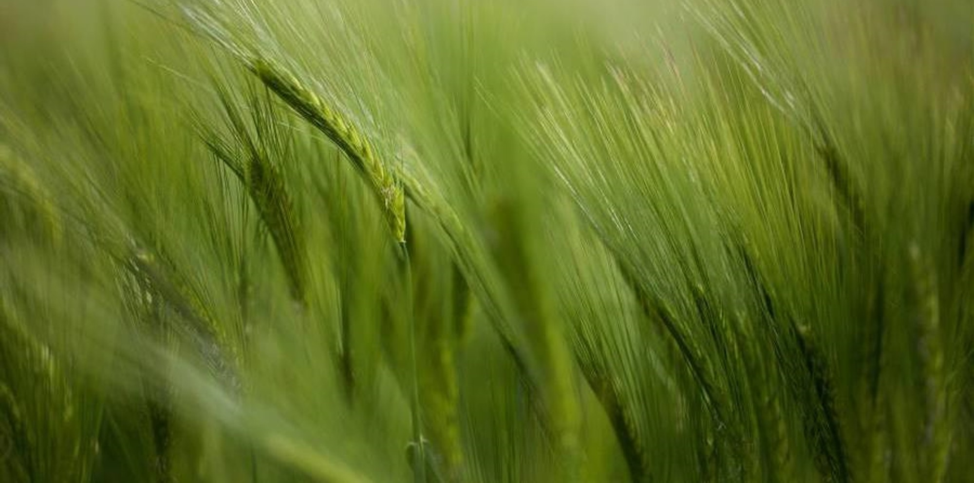
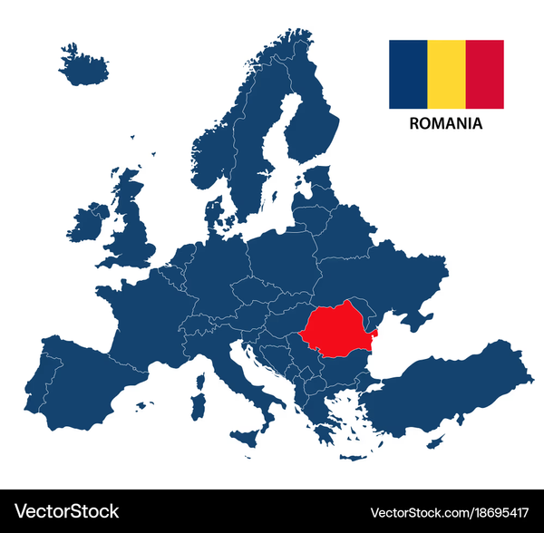
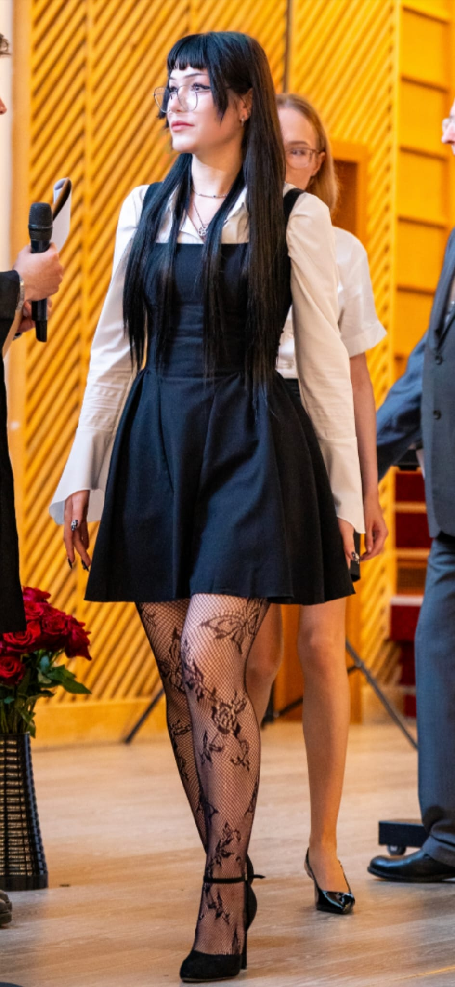
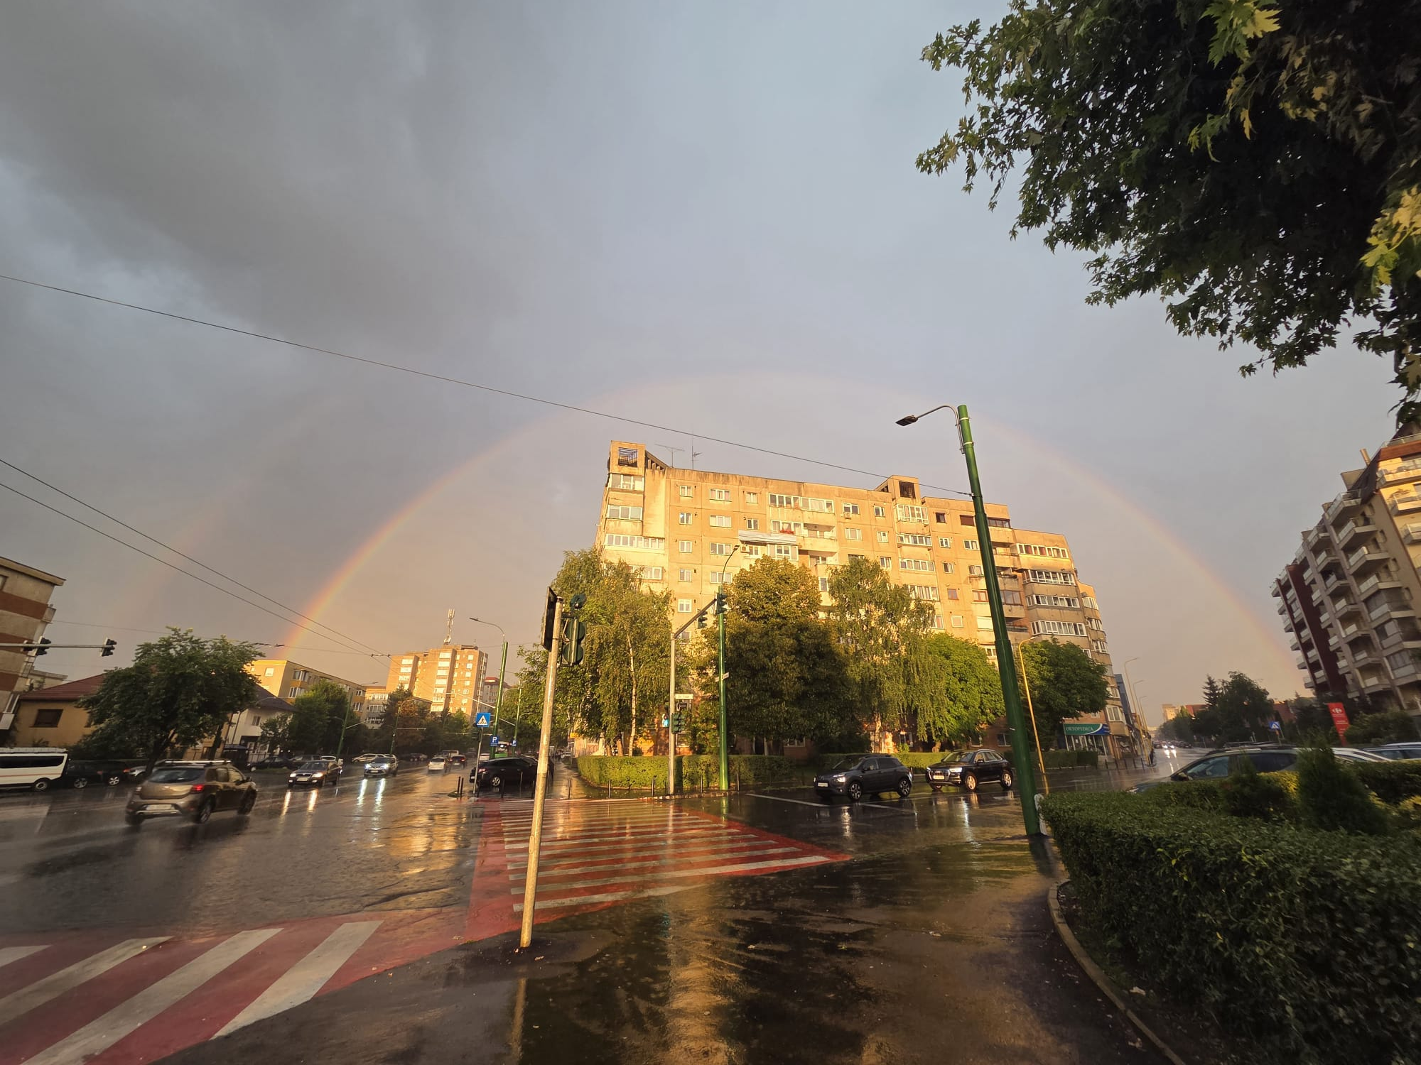



Marin Andreea-Raluca
University: ”Transilvania” University of Brasov
Study program: Renewable Energy Systems Engineering
Year of study: 3rd year/ 6th semester
City: Brașov, Romania
Motto for life: If it works, don’t touch it.
Hobbies: Baking, gaming, crocheting, listen to music, running
Your expectations from the summer school: I want to learn new things and meet new people. I hope to grow personally through collaboration and new experiences.
Location where I study and live
Karlsruhe
31 August to 11 September 2026

